Slide 1
Basics Of Networking

Slide 2
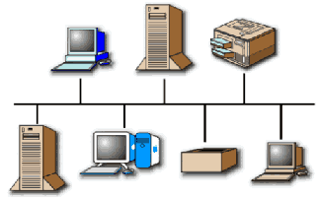
What is a Computer Network?
A network is a collection of computers, printers, routers, switches, and other devices that are able to communicate with each other over some transmission media.
Types of Networks
There are two basic types of networks currently in existence:
A Local Area Network (LAN)
A Wide Area Network (WAN)

Slide 3
Local Area Networks (LAN) | A Local Area Network (LAN) is a group of computers and network communication devices within a limited geographic area, such as an office building. No third party involvement here. They are characterized by the following: High data transfer speeds Generally less expensive technologies Limited geographic area
Wide Area Networks (WAN) | A Wide Area Network (WAN) interconnects LANs. It is not restricted to a particular geographic area and may be interconnected around the world. Third party network is involved. They are characterized by the following: Multiple interconnected LANs Generally more expensive technology More sophisticated to implement than LANs Exist in an unlimited geographic area Less error resistance due to transmission travel distances

Slide 4
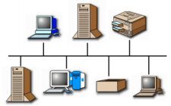
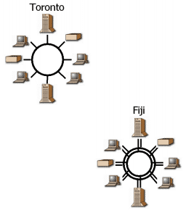
Common LAN Topologies
Bus Architecture
In a bus topology:
  a single cable connects each workstation in a linear, daisy-chained fashion.
  signals are broadcasted to all stations, but stations only act on the frames addressed to them.
Ring Architecture
In a ring topology:
  Unidirectional links connect the transmit side of one device to the receive side of another device.
  Devices transmit frames to the next device (downstream member) in the ring.

Slide 5
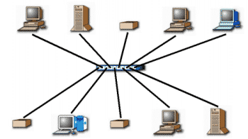
Star Topology
In a star topology, each station is connected to a central hub or concentrator that functions as a multi-port repeater. Each station broadcasts to all of the devices connected to the hub. Physical LAN topologies are usually characterized as either bus or ring.

Slide 6
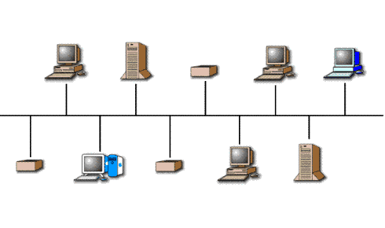
LAN Transmission Methods
LAN transmission methods fall into 3 main categories:
Unicast transmission Multicast transmission Broadcast transmission
Unicast Transmission
In unicast transmissions, a single data packet is sent from a source to a single destination on the network.
Unicast Process
The source addresses
the packet with the
destination address.
The packet is sent into
the network.
The network delivers the
packet to the destination.

Slide 7
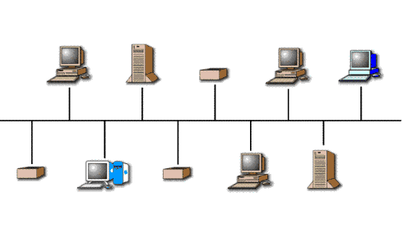
Multicast Transmission
In multicast transmissions, a single data packet is copied and sent to specific destinations on the network
Multicast Process
The source addresses the packet
using a multicast address.
The packet is sent into the
network.
The network copies the packet.
A copy is delivered to each
destination that is included in the
multicast address.
Broadcast Tranmission
In multicast transmissions, a single data packet is copied and sent to specific destinations on the network

Slide 8
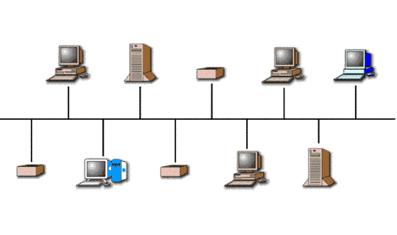
Broadcast Process
The source addresses the packet with the broadcast address.
The packet is sent into the network.
The network copies the packet.
The packet copies are delivered to all destinations on the
network.

Slide 9
LAN Infrastructure Devices
There are numerous devices associated with data information flow across a LAN. When adjoined, they create the infrastructure of a functional LAN. These devices include:
Repeaters Bridges Hubs Switches Routers

Slide 10



Repeaters
Repeaters, located within the physical layer of a network, regenerate and propagate signals from one to another. They do not change any information being transmitted, and they cannot filter any information. Repeaters help to extend the distances of networks by boosting weak signals.
Bridges
Bridges are intelligent repeaters. They regenerate transmitted signals, but unlike repeaters, they can also determine destinations.
Hubs
Hubs connect all computer LAN connections into one device. They are nothing more than multiport repeaters. Hubs cannot determine destinations; they merely transmit to every line attached in a half-duplex mode.
Routers
Routers are a step up from bridges. They are able to route and filter information to different networks. Some routers can automatically detect problems and redirect information around the problem area. These are called "intelligent routers."

Slide 11

Switches
Switches connect all computer LAN connections, the same as hubs do. The difference is that switches can run in full-duplex mode and are able to direct and filter information to and from specific destinations.
WAN
WAN Infrastructure
As with LANs, there are numerous devices associated with data information flow across a WAN. Together, these devices create the infrastructure of a functional WAN. These devices include:
Router ATM Switch Modem and CSU/DSU Communication Server Multiplexer X.25/Frame Relay Switches

Slide 12


ATM Switches
ATM Switches provide high-speed transfer between both LANs and WANs.
Modem (modulator / demodulator)
Modems convert digital and analog signals. At the source, modems convert digital signals to a form suitable for transmission over analog communication facilities (public telephone lines). At the destination, modems convert the signal back to a digital format.
CSU/DSU (Channel Service Unit / Data Service Unit)
CSUs/DSUs are similar to modems, however they send data in digital format across digital telephone loops. They are usually in a physical box, but they may come in two separate units: CSUs or DSUs.

Slide 13
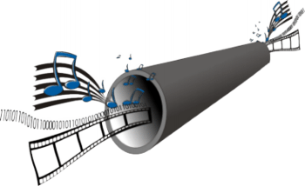
Multiplexers
A Multiplexer combines multiple signals for transmission over a single circuit. This allows for the transfer of various data simultaneously, such as video, sound, text, etc.
Communication Servers
Communication Servers are typically dial in/out servers that allow users to dial in from remote locations and attach to the LAN.
X.25 / Frame Relay Switches
X.25 and Frame Relay Switches connect private data over public data circuits using digital signal. These units are very similar to ATM switches, but the transfer rate of data is not comparable.

Slide 14
Local Area Network Cabling
The earliest LANs used coaxial cables. Over time, the twisted pair cables used in telephone systems were improved to carry higher frequencies and support LAN traffic. More recently, fiber optic cables have emerged as a high-speed cabling option. Local Area Networks use four types of cables:
Coaxial Unshielded Twisted Pair (UTP) Shielded Twisted Pair (STP) Fiber Optic

Slide 15
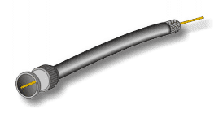
Coaxial Cables
 | A coaxial cable consists of: a single copper conductor a layer of shielding with a ground wire an outer jacket
Coaxial cables are sometimes used for bus topologies, but many LAN products are dropping support of coaxial cable connectivity.
The Ethernet LAN protocol was originally developed to operate over coaxial cables. 10Base5 / Thicknet cable: was the original Ethernet cable. is no longer in use in modern LANs. 10Base2 / Thinnet cable: has a smaller diameter than Thicknet. replaced Thicknet. is no longer recommended, but is still used in some very small LANs.

Slide 16
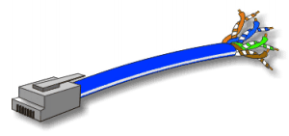
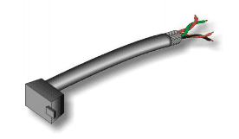
Unshielded Twisted Pair
Unshielded twisted pair (UTP) cable is used for both LANs and telephone systems. UTP cables are composed of four color-coded pairs of copper conductors twisted around each other. An outer jacket provides protection and keeps the pairs in alignment. UTP cable connects to devices via 8 pin modular connectors called RJ-45 plugs. All LAN protocols can operate over UTP. Most modern LAN devices are equipped with RJ-45 jacks.
Shielded Twisted Pair
STP cable is also used for Data Networks. It originated with IBM's Token-Ring networks. Its shielding allows greater tolerances for protection from EMI interference, such as from flourescent light fixtures and electric motors.

Slide 17
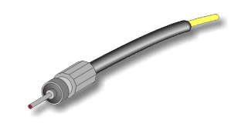
Fiber Optic Cable
Fiber Optic cables are the latest development in cabling technology. They are constructed from optical glass. There is a central glass filament, called the core, and surrounding layers of cladding, buffer coatings, strengthening materials, and an outer jacket.
Information is transmitted by wavelengths of light. This is accomplished through devices that convert electrical signals into rapid pulses of either LED or Laser light.
Fiber optic cables offer several advantages, including:
high bandwidth capacity (many gigabits per second).
longer distances between devices (from 2 to over 60 kilometers).
immunity to electromagnetic interferences
Fiber optic cables are widely used in WANs for both voice and data communications. The primary barrier to their widespread use in LANs is the cost of electronics.

Slide 18
Ethernet
Ethernet was developed by Xerox in 1970. It was implemented through thicknet cable running at 10 Mbps.
Ethernet is a connection media access method that allows all hosts on a network to share the same bandwidth of a link.
Ethernet actually just refers to the LAN implementations that includes three principal categories.
Ethernet / IEEE 802.3---operates at 10 Mbps on coaxial cable and twisted
pair cable.
100-Mbps Ethernet---(also known as Fast Ethernet) operates at 100 Mbps
over twisted-pair cable.
1000-Mbps Ethernet---( also known as Gigabit Ethernet) operates at 1000
Mbps (1 Gbps) over fiber and twisted-pair cables.
Basic Operation
Ethernet and IEEE 802.3 operation involves three basic components:
Transmission Media access Collision handling

Slide 19

Media Access
The Ethernet media access uses the following process: Any station on a LAN can access the network at any time. Before sending data, stations listen for traffic on the network. A station waits until it detects no traffic before it transmits data.
Collision handling
Ethernet is a "first come, first serve" environment. In such an environment, any station on the network can transmit whenever the network is quiet. A collision occurs when two stations listen for traffic, hear none, and then transmit data at the same time. Both transmissions are damaged, and the stations must retransmit at a later time.
CSMA / CD

Slide 20
Ehernet Cabling
Striaght Through cable: used to connect
Host to switch or hub
Router to switch or hub
Four wires are used in straight-through cable to connect Ethernet devices.
1 1
2 2
3 3
6 6
Striaght Through cable: used to connect
switch to switch
Router direct to host
hub to hub
Host to host
Four wires are used as in straight-through cable to connect Ethernet devices.
1 1
2 2
3 3
6 6

Slide 21
Start HyperTerminal to create a console connection and configure the device.
Start Programs accessories communications HyperTerminal
Provide the default settings for com1 port
Rolled cable
Although rolled cable is not used to connect any Ethernet connections together, we use this cable to connect a host to a router console serial communication (com) port.
Eight wires are used in this cable to connect serial devices.
1 1
2 2
3 3
4 4
5 5
6 6
7 7
8 8

Slide 22
Network Model Overview
In order for a computer to send information to another computer, and for that computer to receive and understand the information, there has to exist a set of rules or standards for this communication process. These standards ensure that varying devices and products can communicate with each other over any network. This set of standards is called a model.
Network Model Advantages
This division provides advantages for the network design, architecture and implementation. These include:
Reduces complexity - by dividing the processes into groups, or layers, implementation of network architecture is less complex Provides compatibility - standardized interfaces allow for "plug-and-play" compatibility and multi-vendor integration Facilitates modularization - developers "swap" out new technologies at each layer keeping the integrity of the network architecture Accelerates evolution of technology - developers focus on technology at one layer while preventing the changes from affecting another layer Simplifies learning - processes broken up into groups divides the complexities into smaller, manageable chunks

Slide 23
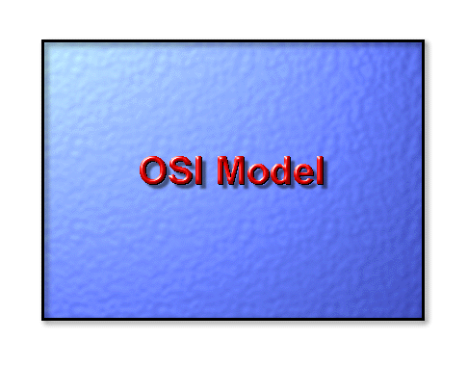

Slide 24
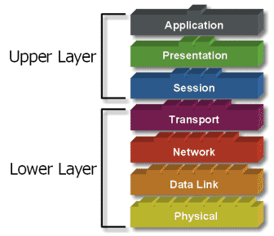
OSI Network Model
There are 7 layers in the OSI model. Each layer is responsible for a particular aspect of data communication. For example, one layer may be responsible for establishing connections between devices, while another layer may be responsible for error checking during transfer.
The layers of the OSI model are divided into two groups: the upper layer and lower layer. The upper layers focus on user applications and how files are represented on the computers prior to transport. For the most part, network engineers are more concerned with the lower layers. It's the lower layers that concentrate on how the communication across a network actually occurs.
ALL People Seem to Need Data Processing (Layer 7 to 1)
Please Do Not Take Sausage Pizzas Away (Layer 1 to 7)

Slide 25
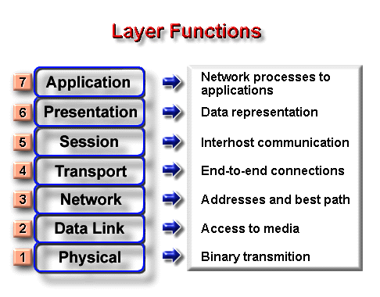

Slide 26
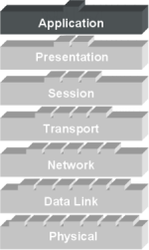
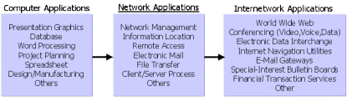
The Application Layer
The Application Layer is the highest layer in the protocol stack and the layer responsible for introducing data into the OSI stack. In it resides the protocols for user applications that incorporate the components of network applications.
Classification of Applications
Computer applications
Network applications
Internetwork applications
Examples: Telnet, FTP, HTTP, WWW Browsers, NFS, SMTP, POP, TFTP .

Slide 27
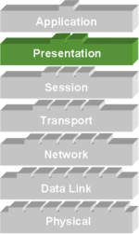

Presentation Layer
The Presentation Layer manipulates the representation of data for transfer to applications on different devices.
The Presentation Layer is responsible for the following services:
Data representation
Data security
Data compression
Data Representation

Slide 28
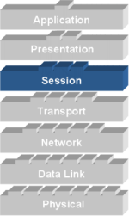
Session Layer
The Session Layer establishes, manages, and terminates sessions (different from connections) between applications as they interact on different hosts on a network.
Its main job is to coordinate the service requests and responses between different hosts for applications.
Examples: NFS, SQL, RPC, ASP
Three different communication modes exists for data transfer within a session connection:
Single-duplex
Half-duplex
Full-duplex.

Slide 29
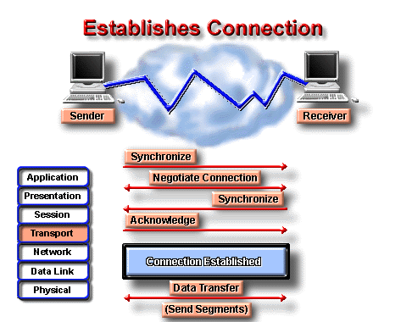
Transport Layer
The basic roles of the Transport Layer are to establish end-to-end connections from one computer to another on the network and provide reliable "transport" of data between devices.
Basic Transport Layer Services:
Resource Utilization (multiplexing)
Connection Management (establishing)
Flow Control (Buffering / Windowing)
Reliable Transport (positive acknowledgment / error checking)
Flow Control
Once the connection has occurred and transfer is in progress, congestion of the data flow can occur at a destination for a variety of reasons. Possible options include:
The destination can become overwhelmed if multiple devices are trying to send it data at the same time.
It may become overwhelmed if the source is sending faster than it can physically receive.

Slide 30
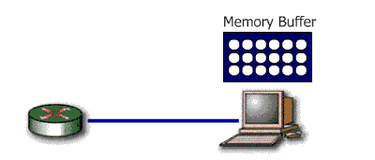
Congestion Prevention
The Transport Layer is responsible for providing flow control to alleviate the issue of congestion and provide reliability in the data transfer. Two main methods for flow control include
Buffering Windowing
Buffering
Buffering is a form of data flow control regulated by the Transport Layer. It is responsible for ensuring that sufficient buffers are available in the destination for the processing of data and that is data transmitted at a rate that does not exceed what the buffer can handle.

Slide 31
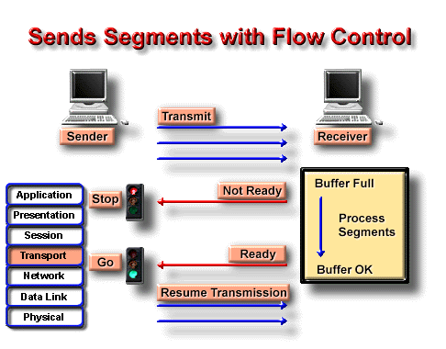

Slide 32
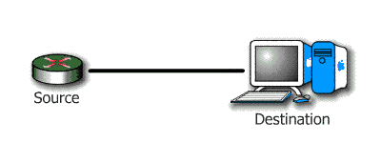

Windowing
Windowing is a flow control scheme in which the source computer will monitor and make adjustments to the amount of information sent based on successful, reliable receipt of data segments by the destination computer. The size of the data transmission, called the "window size", is negotiated at the time of connection establishment. It is determined by the amount of memory or buffer that is available.
Given a window size of 3, the source (in this case a router) sends 3 data segments to the destination. The destination sends an acknowledgement asking for the next set of data segments.
If the destination does not receive all three of the negotiated data segments, for example, due to a buffer overflow, it sends no acknowledgment. Since the source does not receive an acknowledgment, it knows the data segments should be retransmitted

Slide 33
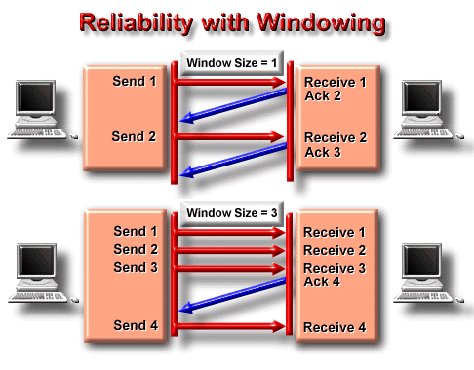

Slide 34
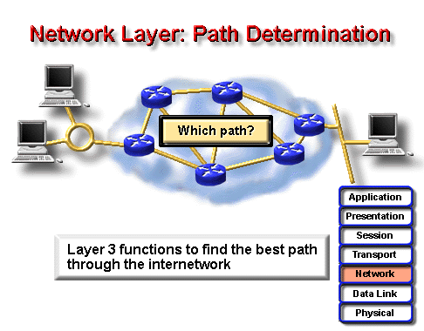
Network Layer
The Network Layer is the 3rd layer in the OSI model and is responsible for identifying computers on a network. This layer works closely with layer 2 to translate data packets from a logical address (similar to an IP address) into hardware based MAC addresses.
This layer is concerned with 2 functions:
Routing
Fragmentation / Reassembly
Two types of packets are used at the Network layer:
Data packets: Used to transport user data through the internetwork. Protocols used to support data traffic are called routed protocols. Eg. IP and IPX.
Route update packets: Used to update neighboring routers about the network connected to all routers within the internetwork. Protocols that send route updates are called routing protocols. Eg. RIP, EIGRP, OSPF

Slide 35
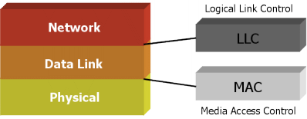
Data Link / Physical Layer
LAN and WAN protocols occupy the bottom two layers of the OSI model. These two layers, Physical Layer and Data Link Layer, work very closely together to ensure data transfer across the physical network. Examples: HDLC, Frame Relay, PPP, ATM, FDDI, IEEE 802.3/802.2
To accomplish accurate delivery, the Data Link Layer provides the following services:
1. Machine address determination of both sending and receiving machines
2. Formatting of Network Layer "packets" into frames with machine addresses
attached
3. Sequencing and resequencing of frames transmitted out of sequence
Data Link Sublayers
Logical Link Control (LLC) responsible for identifying Network layer protocols and encapsulating them.
Media Access Control (MAC) defines how packets are placed on media

Slide 36

Physical Layer
The Physical Layer is the lowest layer in the OSI model and is concerned with how the physical structure of the network enables transmission of data. It is responsible for defining the mechanical and electrical specifications for the transmission medium within a connection, as well as the transformation or encoding of data into “bits”.
Examples:EIA/TIA-232, V.35, EIA/TIA-449, RJ-45, Ethernet, 802.3
Protocols
Protocols defined at the Physical Layer standardize physical connections. Specifications include voltage levels, maximum transmission distances, data rates, and physical connectors.

Slide 37
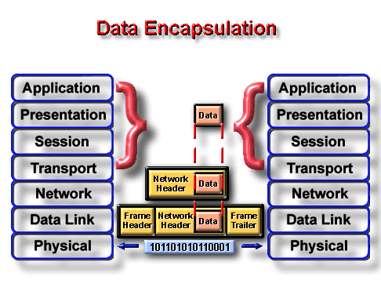
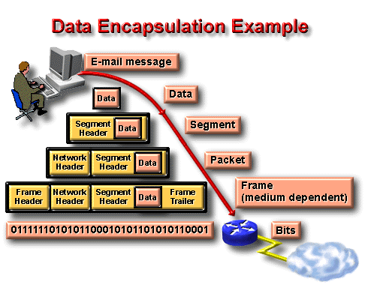
Each layer depends on the service function of the ISO/OSI layer below it. To provide this service, the lower layer uses encapsulation to put the PDU from the upper layer into its data field; then it can add whatever headers and trailers the layer will use to perform its function.
As networks perform services for users, the flow and packaging of the information changes. In this example of internetworking, five conversion steps occur:

Slide 38
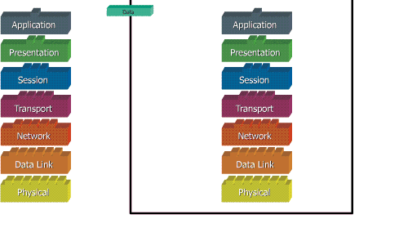
What do the 7 layers really do?

Slide 39
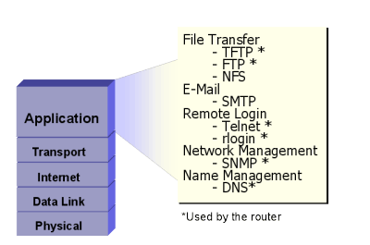
TCP/IP
The Transmission Control Protocol/Internet Protocol (TCP/IP) suite of protocols was developed as part of the research done by the Defense Advanced Research Projects Agency (DARPA).
TCP/IP Protocol Layers
Process/Application Layer
Transport Layer or Host-to-Host Layer
Internet Layer
Network Access Layer
Application protocols exist for file transfer, e-mail, and remote login. Network management is also supported at the application layer.

Slide 40
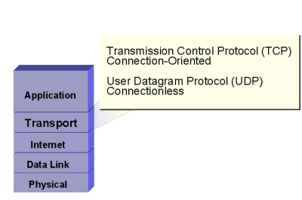
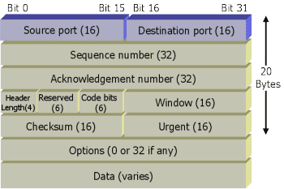

Transport services allow users to segment and reassemble several upper-layer applications onto the same transport-layer data stream.
TCP Segment
UDP Segment

Slide 41
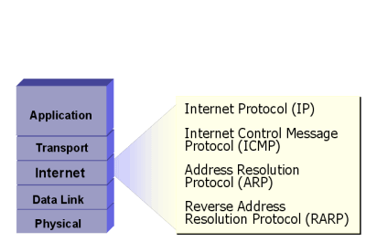
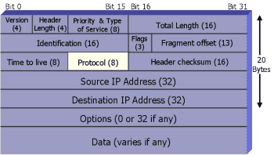
IP provides connectionless, best-effort delivery routing of datagrams. It is not concerned with the content of the datagrams. Instead, it looks for a way to move the datagrams to their destination.
IP Datagram
Version - Version number (4 bits)
Header Length - Header length in 32-bit words (4 bits)
Priority and Type of Service - How the datagram should be handled. The first 3 bits are priority bits (8 bits).
IP Options - Network testing, debugging, security, and others (0 or 32 bits if any)

Slide 42
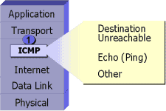
ICMP
The Internet Control Message Protocol (ICMP) is implemented by all TCP/IP hosts. ICMP messages are carried in IP datagrams and are used to send error and control messages.
ICMP uses the following types of defined messages:
1. Destination Unreachable
2. Time Exceeded
3. Parameter Problem
4. Subnet Mask Request
5. Redirect
6. Echo
7. Echo Reply
8. Information Request
9. Information Reply
10.Address Request
11.Address Reply

Slide 43
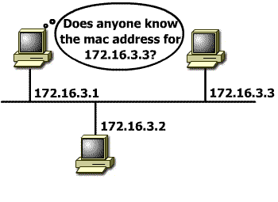
Address Resolution Protocol
Address Resolution Protocol (ARP) is used to resolve or map a known IP address to a MAC sublayer address to allow communication on a multi-access medium such as Ethernet.
The term local ARP is used to describe resolving an address when both the requesting host and the destination host share the same media or wire.

Slide 44
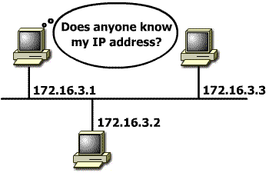
Reverse ARP
Reverse Address Resolution Protocol (RARP) relies on the presence of a RARP server with a table entry or other means to respond to these requests.
ARP and RARP are implemented directly on top of the data link layer

Slide 45
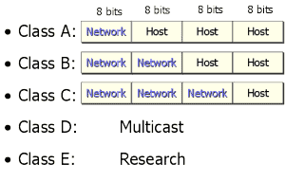
IP Address
In a TCP/IP environment, end stations communicate seamlessly with servers or other end stations. This communication occurs because each node using the TCP/IP protocol suite has a unique 32-bit logical IP address.
Each IP datagram includes the source IP address and destination IP address that identifies the source and destination network and host.
When IP was first developed, there were no classes of addresses. Now, for ease of administration, the IP addresses are broken up into classes.
The bits in the first octet identify the address class. The router uses the first bits to identify how many bits it must match to interpret the network portion of the address

Slide 46
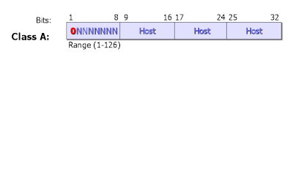
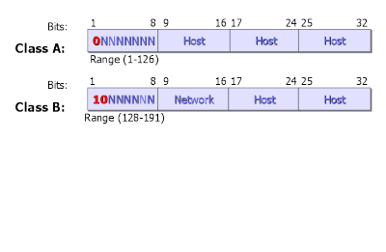
 | Class A addresses include the following: The first bit is 0. Range of network numbers: 1.0.0.0 to 126.0.0.0 Number of possible networks: 127 (1- 126 usable, 127 is reserved) Number of possible values in the host portion: 16,777,216.
 | Class B addresses include the following: The first two bits are 10. Range of network numbers: 128.0.0.0 to 191.255.0.0 Number of possible networks: 16,384 Number of possible values in the host portion: 65,536

Slide 47
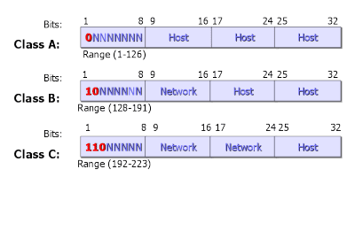
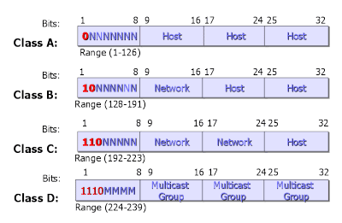
 | Class C addresses include the following: The first three bits are 110. Range of network numbers: 192.0.0.0 to 223.255.255.0 Number of possible networks: 2,097,152 Number of possible values in the host portion: 256
Class D addresses include the following:
Range of network numbers:
224.0.0.0 to 239.255.255.255

Slide 48
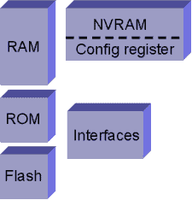
Major Components of a Router
Random access memory (RAM) contains the software and data structures that allow the router to function. The principle software running in RAM is the Cisco IOS image and the running configuration.
Read-only memory contains microcode for basic functions to start and maintain the router.
Flash is primarily used to contain the IOS software image. Some routers run the IOS image directly from Flash and do not need to transfer it to RAM.
Non-volatile random access memory is mainly used to store the configuration. NVRAM uses a battery to maintain the data when power is removed from the router.
Configuration Register The configuration register is used to control how the router boots up.

Slide 49
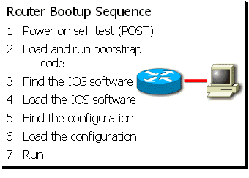
Overview of Cisco Device Startup
This event is a series of hardware tests to verify that all components of the router are functional. POST executes from microcode resident in the system ROM.
Bootstrap code is used to perform subsequent events like finding the IOS software, loading it, and then running it.
3. The bootstrap code determines where the IOS software to be run is
located. The configuration register, configuration file, or Flash memory
are the normal places to house the IOS image.
4. Once the bootstrap code has found the proper image, it then loads that
image into RAM and starts the IOS running
5. The default is to look in NVRAM for a valid configuration.
6. The desired configuration for the router is loaded and executed.

Slide 50
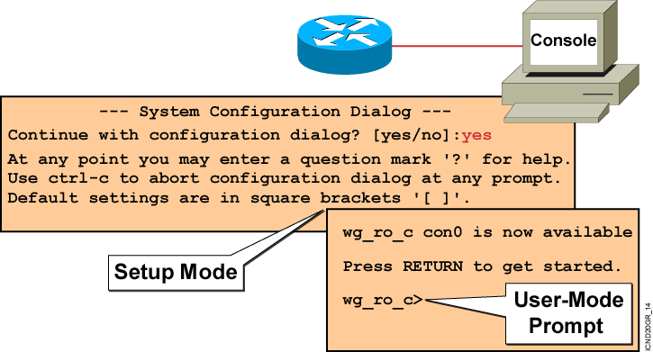
Bootup Output from the Router

Slide 51
Setup: The Initial
Configuration Dialog
Router#setup
--- System Configuration Dialog ---
Continue with configuration dialog? [yes/no]: yes
At any point you may enter a question mark '?' for help.
Use ctrl-c to abort configuration dialog at any prompt.
Default settings are in square brackets '[]'.
Basic management setup configures only enough connectivity
for management of the system, extended setup will ask you
to configure each interface on the system
Would you like to enter basic management setup? [yes/no]: no

Slide 52
Setup Interface Summary
First, would you like to see the current interface summary? [yes]:
Interface IP-Address OK? Method Status Protocol
BRI0 unassigned YES unset administratively down down
BRI0:1 unassigned YES unset administratively down down
BRI0:2 unassigned YES unset administratively down down
E0 unassigned YES unset administratively down down
Serial0 unassigned YES unset administratively down down
Setup Initial
Global Parameters

Slide 53
Configuring global parameters:
Enter host name [Router]:wg_ro_c
The enable secret is a password used to protect access to
privileged EXEC and configuration modes. This password, after
entered, becomes encrypted in the configuration.
Enter enable secret: cisco
The enable password is used when you do not specify an
enable secret password, with some older software versions, and
some boot images.
Enter enable password: sanfran
The virtual terminal password is used to protect
access to the router over a network interface.
Enter virtual terminal password: sanjose
Configure SNMP Network Management? [no]:
Configure LAT? [yes]: no
Configure AppleTalk? [no]:
Configure DECnet? [no]:
Configure IP? [yes]:
Configure IGRP routing? [yes]: no
Configure RIP routing? [no]:
Configure CLNS? [no]:
Configure IPX? [no]:
Configure Vines? [no]:
Configure XNS? [no]:
Configure Apollo? [no]:
Setup Initial
Protocol Configurations

Slide 54
Setup Interface
Parameters
BRI interface needs isdn switch-type to be configured
Valid switch types are :
[0] none..........Only if you don't want to configure BRI.
[1] basic-1tr6....1TR6 switch type for Germany
[2] basic-5ess....AT&T 5ESS switch type for the US/Canada
[3] basic-dms100..Northern DMS-100 switch type for US/Canada
[4] basic-net3....NET3 switch type for UK and Europe
[5] basic-ni......National ISDN switch type
[6] basic-ts013...TS013 switch type for Australia
[7] ntt...........NTT switch type for Japan
[8] vn3...........VN3 and VN4 switch types for France
Choose ISDN BRI Switch Type [2]:
Configuring interface parameters:
Do you want to configure BRI0 (BRI d-channel) interface? [no]:
Do you want to configure Ethernet0 interface? [no]: yes
Configure IP on this interface? [no]: yes
IP address for this interface: 10.1.1.33
Subnet mask for this interface [255.0.0.0] : 255.255.255.0
Class A network is 10.0.0.0, 24 subnet bits; mask is /24
Do you want to configure Serial0 interface? [no]:

Slide 55
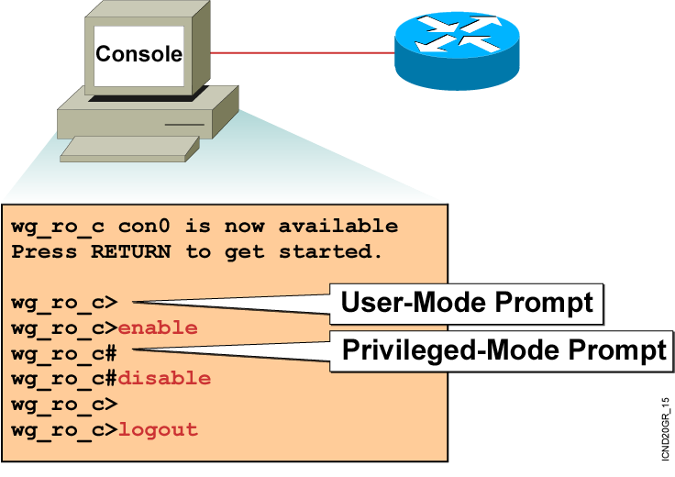
Logging In to the Router

Slide 56
Router User-Mode
Command List
Router>?
Exec commands:
access-enable Create a temporary Access-List entry
atmsig Execute Atm Signalling Commands
cd Change current device
clear Reset functions
connect Open a terminal connection
dir List files on given device
disable Turn off privileged commands
disconnect Disconnect an existing network connection
enable Turn on privileged commands
exit Exit from the EXEC
help Description of the interactive help system
lat Open a lat connection
lock Lock the terminal
login Log in as a particular user
logout Exit from the EXEC
-- More --

Slide 57
Router Privileged-Mode
Command List
Router#?
Exec commands:
access-enable Create a temporary Access-List entry
access-profile Apply user-profile to interface
access-template Create a temporary Access-List entry
bfe For manual emergency modes setting
cd Change current directory
clear Reset functions
clock Manage the system clock
configure Enter configuration mode
connect Open a terminal connection
copy Copy from one file to another
debug Debugging functions (see also 'undebug')
delete Delete a file
dir List files on a filesystem
disable Turn off privileged commands
disconnect Disconnect an existing network connection
enable Turn on privileged commands
erase Erase a filesystem
exit Exit from the EXEC
help Description of the interactive help system
-- More --

Slide 58
Enhanced Editing Commands
(Automatic scrolling of long lines.)
Ctrl-A
Move to the beginning of the command line.
Ctrl-E
Move to the end of the command line.
Esc-B
Move back one word.
Esc-F
Move forward one word.
Ctrl-B
Move back one character.
Ctrl-F
Move forward one character.
Ctrl-D
Delete a single character.
Ctrl-P or Up Arrow
Recalls last (previous) commands
Ctrl-N or Down Arrow
Recalls more recent commands
show history
Shows command buffer contents
history size line
Sets the buffer size permanently
terminal history size lines
Sets session command buffer size

Slide 59
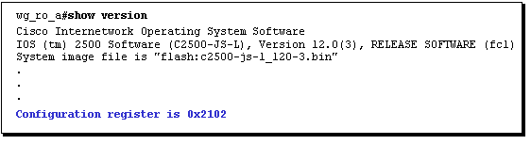

Examining the Register Configuration
The configuration register is a 16-bit register. The lowest four bits of the configuration register (bits 3, 2, 1, and 0) form the boot field.
You can change the default configuration register setting with the enabled config-mode config-register command.

Slide 60
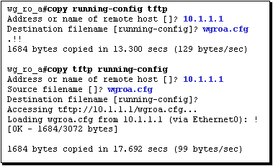
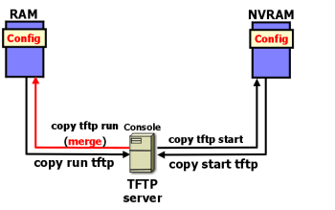
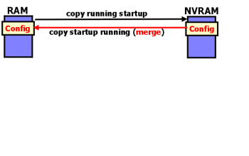
Examining the IOS Copy Command

Slide 61


Router#show flash
System flash directory:
File Length Name/status
1 10084696 c2500-js-l_120-3.bin
[10084760 bytes used, 6692456 available, 16777216 total]
16384K bytes of processor board System flash (Read ONLY)
Router#copy tftp flash
Address or name of remote host? 10.1.1.1
Source filename? c2500-js-l_120-3.bin
Accessing tftp://10.1.1.1/c2500-js-l_120-3.bin...
Erase flash befor copying? [Enter]
Erasing the flash filesystem will remove all files! Continue? [Enter]
Erasing device... eeeee(output omitted) ...erased
Erase of flash: complete
Loading c2500-js-l_120-3.bin from 10.1.1.1 (via Ethernet0): !!!!!!!!!!!!!!!!!!!!
(output omitted)
[OK - 10084696/20168704 bytes]
Verifying checksum... OK (0x9AA0)
10084696 bytes copied in 309.108 secs (32636 bytes/sec)
Router#

Slide 62
The following example demonstrates the sequence of commands you would enter to configure various passwords on a router with the following characteristics:
Console password is cisco
Telnet password is cisco
Privileged Mode password is cisco
Secret password is cisco
Router(config)#line console 0
Router(config-line)#login
Router(config-line)#password cisco
Router(config-line)#exit
Router(config)#line vty 0 4
Router(config-line)#login
Router(config-line)#password cisco
Router(config-line)#exit
Router(config)#enable password ccna
Router(config)#enable secret cisco
Router(config)#service password-encryption
interface Command Syntax
router(config)#interface ethernet 1
router(config-if)#ip address 10.1.1.1 255.0.0.0
router(config-if)#no shut

Slide 63

The following example demonstrates the sequence of commands you would enter to configure a serial line on a router with the following characteristics:
  Router interface is serial 0
  Clock Rate is 64000
  Bandwidth is 64 kbits
  Router#configure terminal
  Router(config)# interface serial 0
  Router(config-if)#clock rate 64000
  Router(config-if)#bandwidth 64
  Router(config-if)# exit
  Router(config)# exit
  Router# show interface serial 0
  Serial 0 is up, line protocol is up
  Hardware is HD64570... MTU 1500 bytes, BW 64000 Kbit,...
Serial Interface show controller Command

Slide 64

By Puneet Kumar

Slide 65

Routing is the process by which an item gets from one location to another. Many items get routed: for example, mail, telephone calls, and trains. In networking, a router is the device used to route traffic.
Key Information a Router Needs
Destination Address - What is the destination (or address) of the item that needs to be routed?
Identifying sources of information - From which source (other routers) can the router learn the paths to given destinations?
Discovering routes - What are the initial possible routes, or paths, to the intended destinations?
Selecting routes - What is the best path to the intended destination?
Maintaining routing information - A way of verifying that the known paths to destinations are the most current.

Slide 66
Routed protocols - Any network protocol that provides enough information in its network layer address to allow a packet to be forwarded from host to host based on the addressing scheme. Routed protocols define the format and use of the fields within a packet. Packets generally are conveyed from end system to end system. The Internet protocol IP is an example of a routed protocol.
Here are some examples of Routed Protocols:
Internet Protocol (IP)
AppleTalk (AT)
Novell NetWare Protocol
Xerox Network Systems (XNS)
Routing protocols - Supports a routed protocol by providing mechanisms for sharing routing information. Routing protocol messages move between the routers. A routing protocol allows the routers to communicate with other routers to update and maintain tables. examples of routing protocols are RIP,IGRP,EIGRP and OSPF.

Slide 67

Types of Routing
The different types of routing are:
Static routing
Default routing
Dynamic routing
Static Routing
Routes learned by the router when an administrator manually establishes the route. The administrator must manually update this static route entry whenever an internetwork topology change requires an update.
Benefits:
There is no overhead on the router CPU.
There is no bandwidth usage between routers
It adds security
Disadvantage:
The administrator must really understand the internetwork and how
each router is connected to configure routes correctly.
If a network is added to internetwork, the administrator has to add route to
it on all routers-by hand

Slide 68

Default Routing
A default route is a special type of static route. A default route is a route to use for situations when the route from a source to a destination is not known or when it is unfeasible for the routing table to store sufficient information about the route.
In the image, Cisco B is configured to forward all frames for which the destination network is not explicitly listed in its routing table to Cisco A.

Slide 69

Dynamic Routing
Routes dynamically learned by the router after an administrator configures a routing protocol that helps determine routes. Unlike static routes, once the network administrator enables dynamic routing, route knowledge is automatically updated by a routing process whenever new topology information is received from the internetwork.

Slide 70
Router Metrics
Routing metrics are used by routing algorithms to determine the desirability of a given route to a destination network. Different routing protocols implement different routing metrics. Routing metrics represent network characteristics. Metric information is stored in routing tables. There are a number of commonly used routing metrics, including:
Path length
Reliability
Delay
Bandwidth
Load
Cost
Hop count is a value that counts the number of intermediate systems (such as
routers) through which a packet must pass to travel from the source to the
destination. The path length is the sum of all the hops in the path.
The reliability routing metric can be based on any of a number of network characteristics. These include:
Bit-error rate (the ratio of received bits that contain errors)
How often each network link fails, and, once down, how quickly each network link can be repaired.
The delay routing metric is based on the length of time required to move a packet from the source to a destination through the internetwork.

Slide 71
Bandwidth
The bandwidth routing metric is based solely on the available traffic capacity of each network link. However, routes through links with greater bandwidth do not necessarily provide better routes than routes through slower links. The load routing metric is based on the degree to which a network resource (such as a router) is busy. Load is calculated according to such factors as: CPU utilization Packets processed per second The cost routing metric is based on the monetary cost of using each network link. For example, a slower company-owned link can be configured as preferable over faster public links that cost money for usage time.
Load
Cost

Slide 72


Slide 73


Routing protocols are used between routers to determine paths and maintain routing tables. Dynamic routing relies on a routing protocol to disseminate knowledge.
Autonomous Systems
An autonomous system is a collection of networks under a common administrative domain

Slide 74

Adminstrative Distance
Multiple routing protocols and static routes may be used at the same time. If there are several sources for routing information, an administrative distance value is used to rate the trustworthiness of each routing information source.
An Administrative Distance is a rating of the trustworthiness of a routing information source, such as an individual router or a group of routers. It is an integer from 0 to 255.
Route Source | Default Distance
Connected interface | 0
Static route address | 1
EIGRP | 90
IGRP | 100
OSPF | 110
RIP | 120
External EIGRP | 170
Unknown / Unbelievable | 255 (Will not be

Slide 75


Slide 76



Distance Vector Protocols
Distance vector routing protocols require routers to periodically send all (or a significant portion) of their routing table in routing updates, but only to neighboring routers.

Slide 77
Routing Loop
Routing loops are, simply, the continuous forwarding of packets due to some fault in a network. Packets are continuously looped throughout a particular network or segment.
What Causes Routing Loops?
Routing loops can occur when routing decisions are based on incorrect information, resulting in packets taking paths that return them to already visited routers. They are created due to a variety of circumstances
How Do Routers Prevent Loops?
Routing protocols implement a variety of features designed to prevent routing loops.
Maximum Hop count Split Horizon Route Poisoning Holddowns
distance vector protocols define infinity as some maximum number. This number refers to a routing metric, such as a hop count.

Slide 78


With this approach, the routing protocol permits the routing loop until the metric exceeds its maximum allowed value. The image shows this defined maximum as 16 hops. Once the metric value exceeds the maximum, network 10.4.0.0 is considered unreachable.
Split Horizon
The rule of split horizon is that it is never useful to send information about a route back in the direction from which the original packet came.

Slide 79


Route Poisoning
With this technique, the router sets a table entry that keeps the network state consistent while other routers gradually converge correctly on the topology change. Used with hold-down timers, which are described soon, route poisoning is a solution to long loops.
Hold-Down
A hold-down timer is a state into which a route is placed so that routers will neither advertise the route nor accept advertisements about the route for a specific length of time (the holddown period). A route is typically placed in holddown when a link in that route fails.

Slide 80

RIP
RIP, or Routing Information Protocol, is a routing protocol located within IP. There are two versions of RIP supported by Cisco. RIP version 1 and an enhanced version RIPv2, a classless routing protocol.
Characteristics of RIP
It is a distance vector routing protocol.
Hop count is used as the metric for path selection.
The maximum allowable hop count is 15.
Routing updates are broadcast every 30 seconds by default.
RIP is capable of load balancing over up to six equal cost paths (4 paths is the default).
RIPv1 requires that for each major classful network number being advertised, only one network mask is used per network number. The mask is a fixed length subnet mask.
RIPv2 permits variable-length subnet masks on the internetwork. (RIPv1 does not do triggered updates but RIPv2 does do triggered updates.)

Slide 81
Procedure for Configuring RIP
Select RIP as the routing protocol using the router rip global configuration command.
Router(config)#router rip
2. Assign a major network number to which the router is directly connected using the network network-number router configuration command.
Router(config-router)#network 10.2.2.0
3.Display network information associated with the entire router using the show ip protocol privileged command.
Router#show ip protocols
4. Display RIP routing updates as they are sent and received using the debug ip rip privileged command.
Router#debug ip rip

Slide 82

IGRP
IGRP is an advanced distance vector routing protocol developed by Cisco in the mid-1980s. IGRP has several features that differentiate it from other distance vector routing protocols, such as RIP.
Characteristics of IGRP
Increased scalability - Improved for routing in larger size networks compared to networks that use RIP.
Sophisticated metric - IGRP uses a composite metric that provides significant route selection flexibility. Internetwork delay and bandwidth by default, and optionally reliability, and load are all factored into the routing decision. IGRP can be used to overcome RIP's 15-hop limit. IGRP has a default maximum hop count of 100 hops, configurable to a maximum of 255 hops.
Multiple paths - IGRP can maintain up to six nonequal paths between a network source and destination; the paths do not mandate equal costs like with RIP. Multiple paths can be used to increase available bandwidth or for route redundancy.

Slide 83
Procedure for Configuring RIP
Define IGRP as the IP routing protocol using the router igrp autonomous-system global configuration command.
Router(config)#router igrp 100
2. Assign a major network number to which the router is directly connected using the network network-number router configuration command.
Router(config-router)#network 10.2.2.0
3. Configure load balancing using the variance multiplier router configuration command.
Router(config-router)#variance 1
4. Configure traffic distribution among IGRP load sharing routes using the traffic-share { balanced | min } router configuration command. Router(config- router)#traffic-share balanced
5.Display network information associated with the entire router using the show ip protocol privileged command.
Router#show ip protocols
6. Display the contents of the IP routing table using the show ip route privileged command.
Router#show ip route

Slide 84

Using Telnet to Connect to Remote Devices

Slide 85

Viewing Telnet Connections

Slide 86

Suspending and Resuming
a Telnet Session

Slide 87

Closing a Telnet Session

Slide 88
Using the ping and trace Commands
Router###ping 10.1.1.10
Type escape sequence to abort.
Sending 5, 100-byte ICMP Echos to 10.1.1.10, timeout is 2 seconds:
!!!!!
Success rate is 100 percent (5/5), round-trip min/avg/max = 4/4/4 ms
Router#trace 192.168.101.101
Type escape sequence to abort.
Tracing the route to 192.168.101.101
1 p1r1 (192.168.1.49) 20 msec 16 msec 16 msec
2 p1r2 (192.168.1.18) 48 msec * 44 msec
Router#

Slide 89


